Slide 1
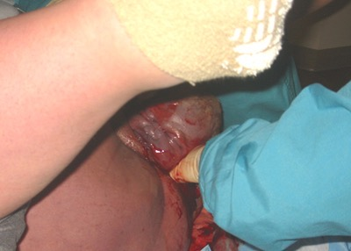
Shoulder dystocia

Slide 2
Macrosomia is the most dominant risk factor

Slide 3
Goal with this CME
Get to know the riskfactors of shoulder dystocia
Learn a systematic way how to solve this crisis
Practice on the manouvers to solve the shoulder dystocia by using the algoritm HELPERR

Slide 4
Riskfactors shoulder dystocia
1. Macrosomia, birthweight over 4500 gram is the most dominant riskfactor. Important to know that 50% of all babies weigh under 4000 gram.
2. Previous shoulder dystocia
3. Diabetes
4.Prolonged labour
5. Obesitas
6. Lenght <150 cm, alternatively abnorm pelvic anatomy

Slide 5
Complications shoulder dystocia
Maternel Neonatal
Soft tissue damage - Asfyxia – death
Sfincter rupture - Plexus injury
Bleeding post partum - Clavicle injury
Uterus rupture. - Humerus fracture

Slide 6
Sign of shoulder dystocia - Turtle sign

Slide 7
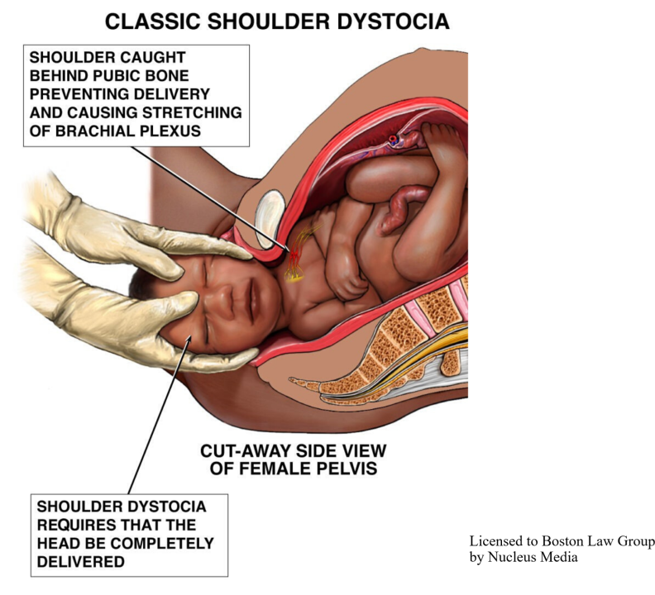
Shoulder caught behind pubic bone

Slide 8
helper4
H = Call for Help
E = Evaluate and explain
L = Legs (McRoberts maneuver)
P = Pressure (Suprapubis)
E = Evaluate Episiotomy
R4 =Removal of posterior arm
Rotatory internal maneuvers
Roll the patient
Repeat

Slide 9
Important!
NO fundus pressure
Don´t tell the woman to push
No contraction needed
If Oxytocin drip, turn it off.
Every maneuver 30-60 seconds
It takes about 7 minutes for Ph to sink from 7,25 to 6,96 (0,04 per minute)

Slide 10
H - Help
Call for help
Many people needed to solve the shoulder dystocia

Slide 11
E - Evaluate and explain
Is it really a shoulder dystocia?
Which shoulder is stuck?
Delegate the different tasks
Give instructions to the mother

Slide 12
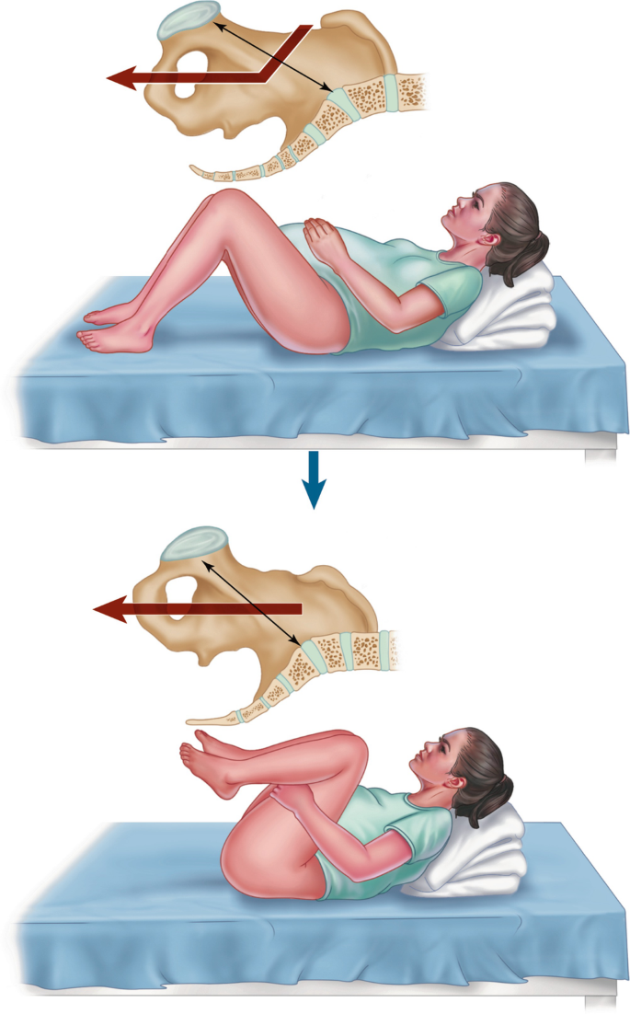
L - Legs
McRoberts maneuver
Bend the mothers legs up towards the stomac
This itself will reduce >40% of all dystocias

Slide 13
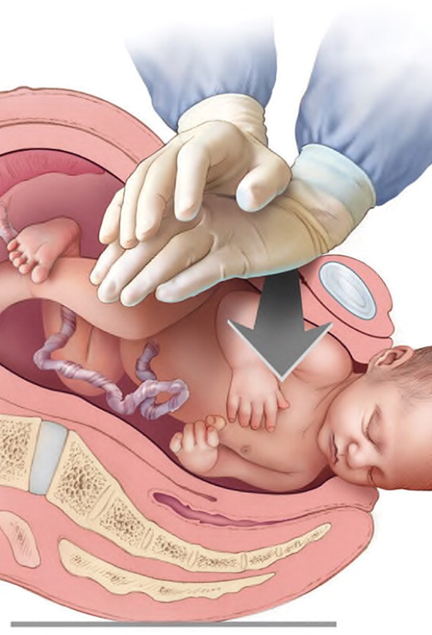
P- pressure
Suprapubis pressure is done by an assistant.
Important that this is done on the babys backside
CPR position of assistants hands
Adduce the front shoulder

Slide 14
E – Evaluate for episiotomy
Shoulder dystocia is not a soft tissue problem
Shoulder dystocia is a bone problem
Episiotomy is done due to get more space during the inner maneuvers

Slide 15
R – Removal of posterior arm
Follow the back arm down towards the elbow
Bend the arm
Sweep the arm over the babys chest
Pulling the hand straight out will cause fractures

Slide 16
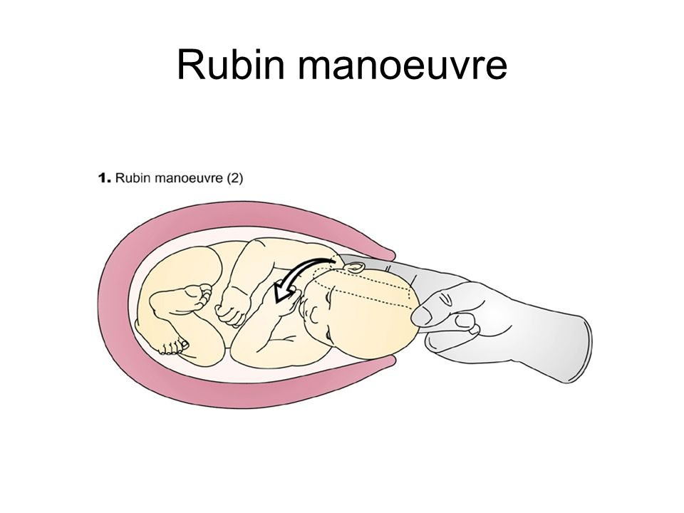
R – Rotatory internal maneuvers
Rubins maneuver
Reach for the front shoulder
Press the shoulder forward to rotate to a oblique position
Continue with Mc Roberts maneuver

Slide 17
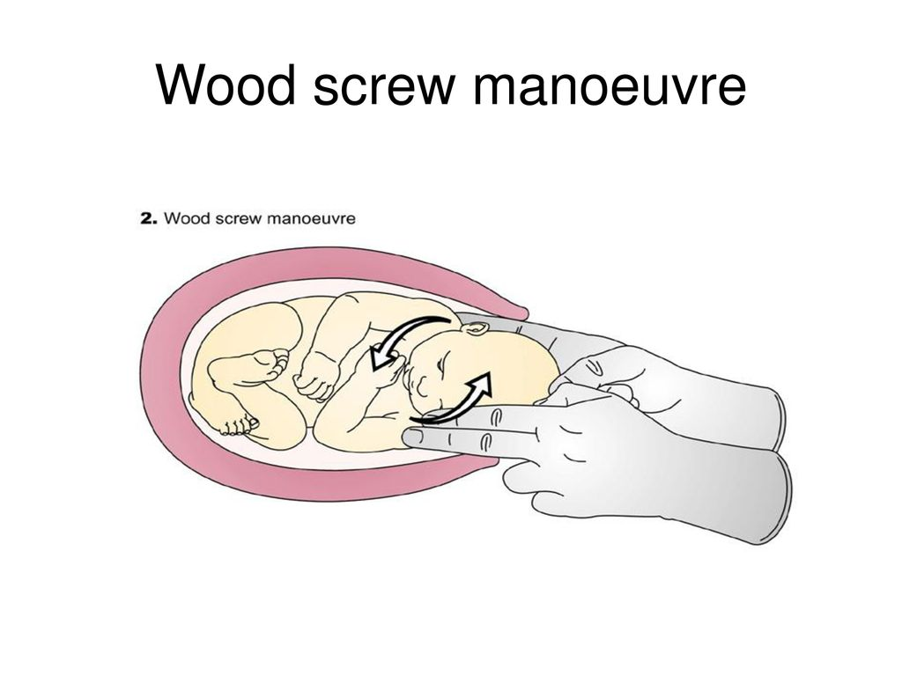
R – Woods maneuver
Wooods maneuver
Reach for the back shoulder from the front
Rotate towards the symphysis
Combine with the Rubins maneuver

Slide 18
R – Roll the patient

Slide 19
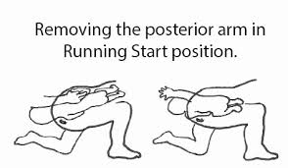
Roll the patient
The movment may solve the shoulder dystocia
It widen the pelvis about 1-2 cm
Deliver the posterior arm

Slide 20
Last move
Axillar slyng traction of back shoulder
Clavicle fracture
Zavanelli maneuver
Muscle relaxant
Abdominal surgery
Symfysiotomy

Slide 21
Axillar Sling traction of back shoulder

