Slide 1
Some more about X-ray…
Dr Malin Häggström
Rotary Doctors Sweden

Slide 2
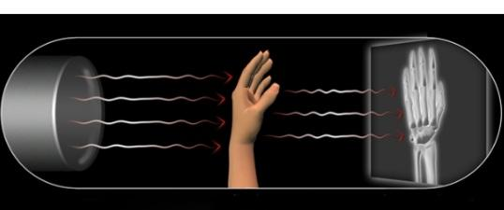
The X-ray picture consists of a summation of all the structures that the X-rays passes through on the way from the camera to the film.

Slide 3
To be fully able to understand what you see on the picture and where that structure is exactly located, you always need two projections. One anterio-posterior and one lateral.

Slide 4
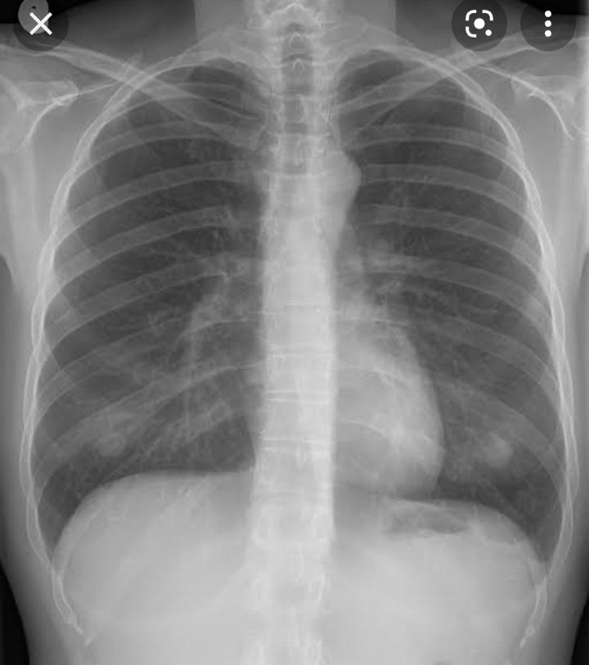

Slide 5
You also need the two projections because structures can be hidden behind other structures for example behind the heart or the diaphragmic dome.

Slide 6
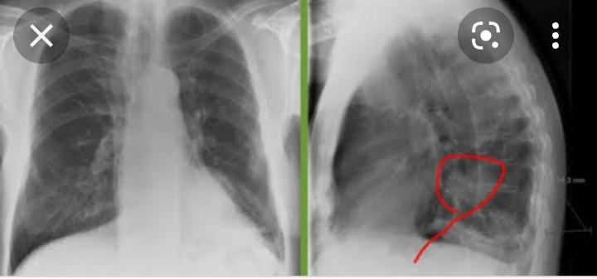

Slide 7
What you can see in a chest X-ray

Slide 8
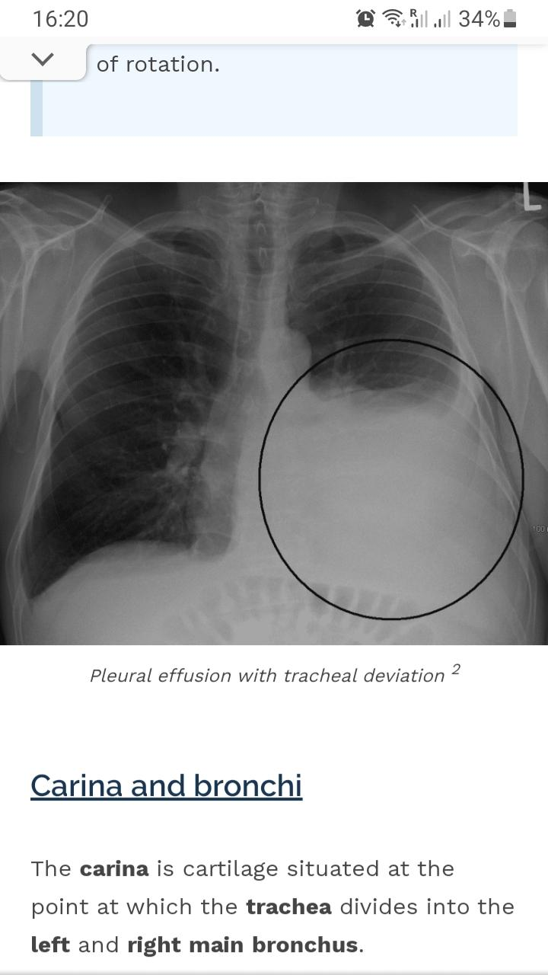

Slide 9
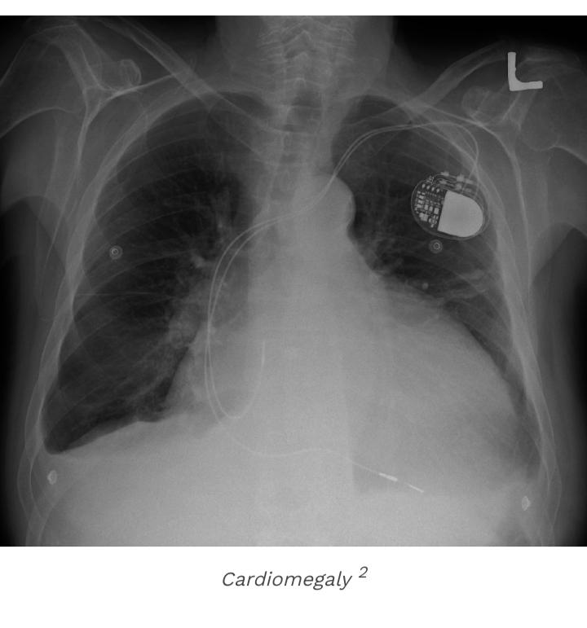

Slide 10
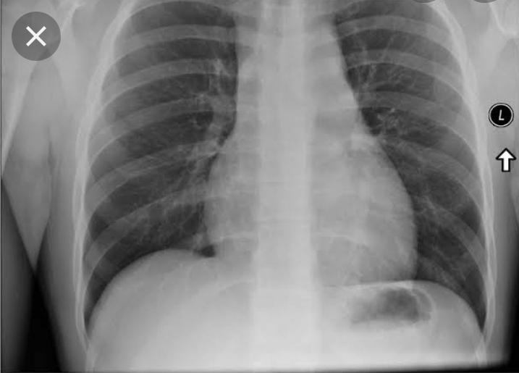

Slide 13
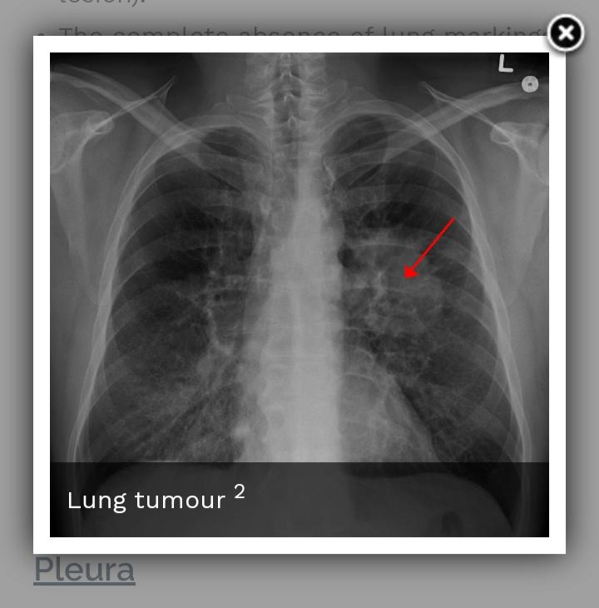

Slide 14
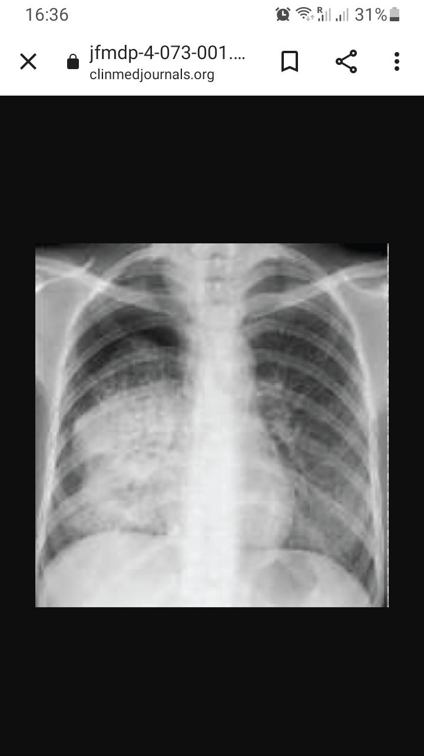

Slide 15
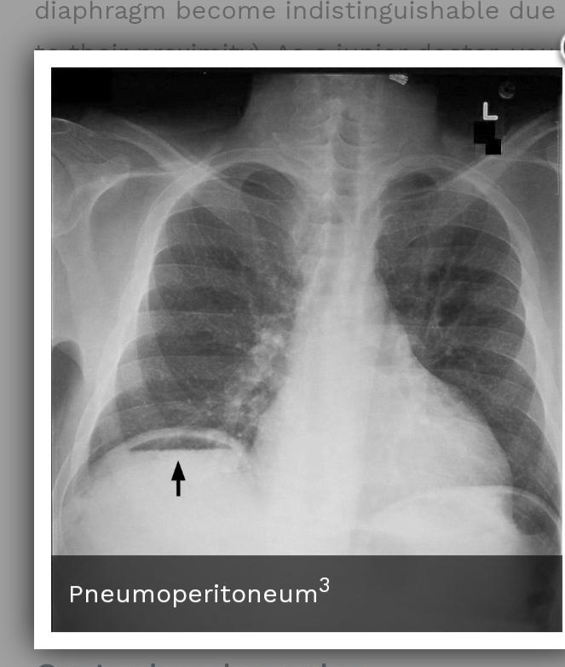

Slide 16
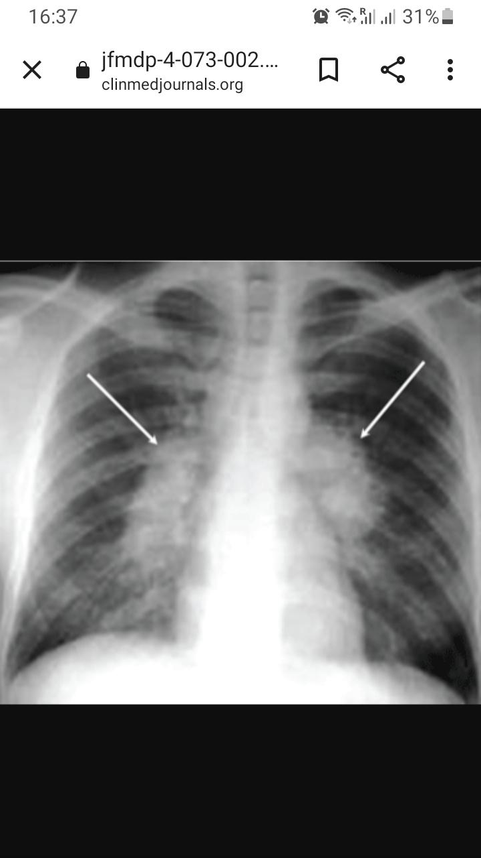

Slide 17
How to interpret a chest X-ray
Preferably you should have a lightboard. Could be easily constructed with a flourescent light and frosted glass.
You should do the interpretation in a structured manner, always the same, not to miss anything. It is good to have some kind of mnemonic, like ABCDE.

Slide 18
Airway: Is trachea in the middle? Follow the two main bronchi. Widened mediastinum?
Bones: Fractures? Lesions?
Cardiac: Heart size
Diaphragm: right side should be higher. Free air beneath?
Effusion: look in the costophrenic angles
Fields: Check all the lungfields for infiltrat, nodules

Slide 19
Signs of TB
You could see signs of active, inactive and latent TB. In this setting we look for active TB as that is contagious.
Active TB in the youth could look like almost anything why it is very important to combine findings with symptoms. For example: pnemonial infiltrate with or without hilar lymphadenopathy, miliar TB, pleural effusion, signs of pulmonary oedema.
Postprimary active TB could look like shady patchy infiltrate with a cavern or fibroproliferativ with a reticonodular pattern.

